Slide 1
Analytical Model to Infer Mask Peripheral Leakage Pattern in Large Population
Group Meeting
Akshay Anand
Tso – Kang Wang

Slide 2
Development Timeline
Past week
This week
Next week
Activities/Issues
Ongoing Effort
Plan/Thoughts
Mask outward protection
Mask inward protection
Wrap up outward protection part of paper
Wrap up outward & Inward protection paper
FEM model / FSI
Outcomes
Success/Failure
Major Results
Anticipated Results
Literature on jet velocity
4 cases fails (P=nan) for facial feature ears
Flux per unit width for each facial feature
Normal velocity
Jet velocity
Some Inward protection model
Running …

Slide 3
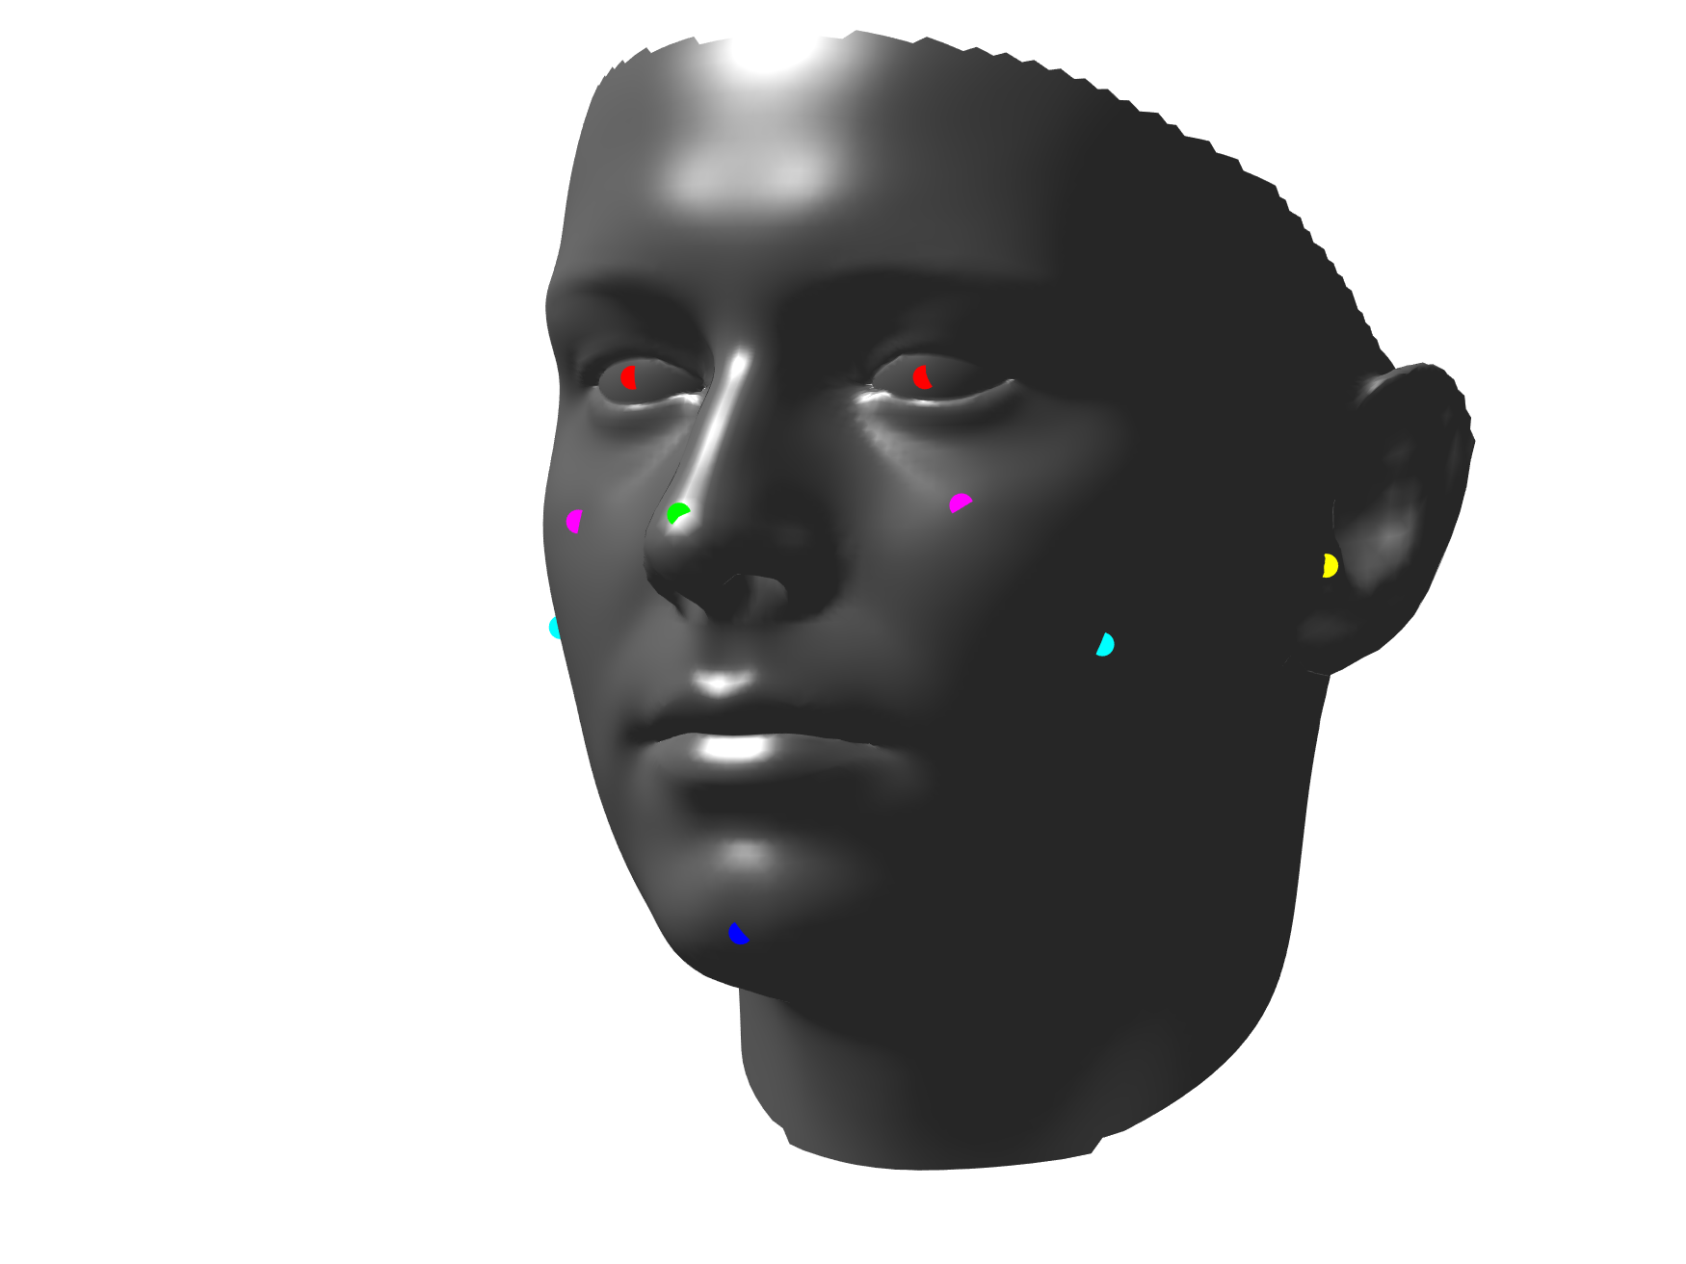
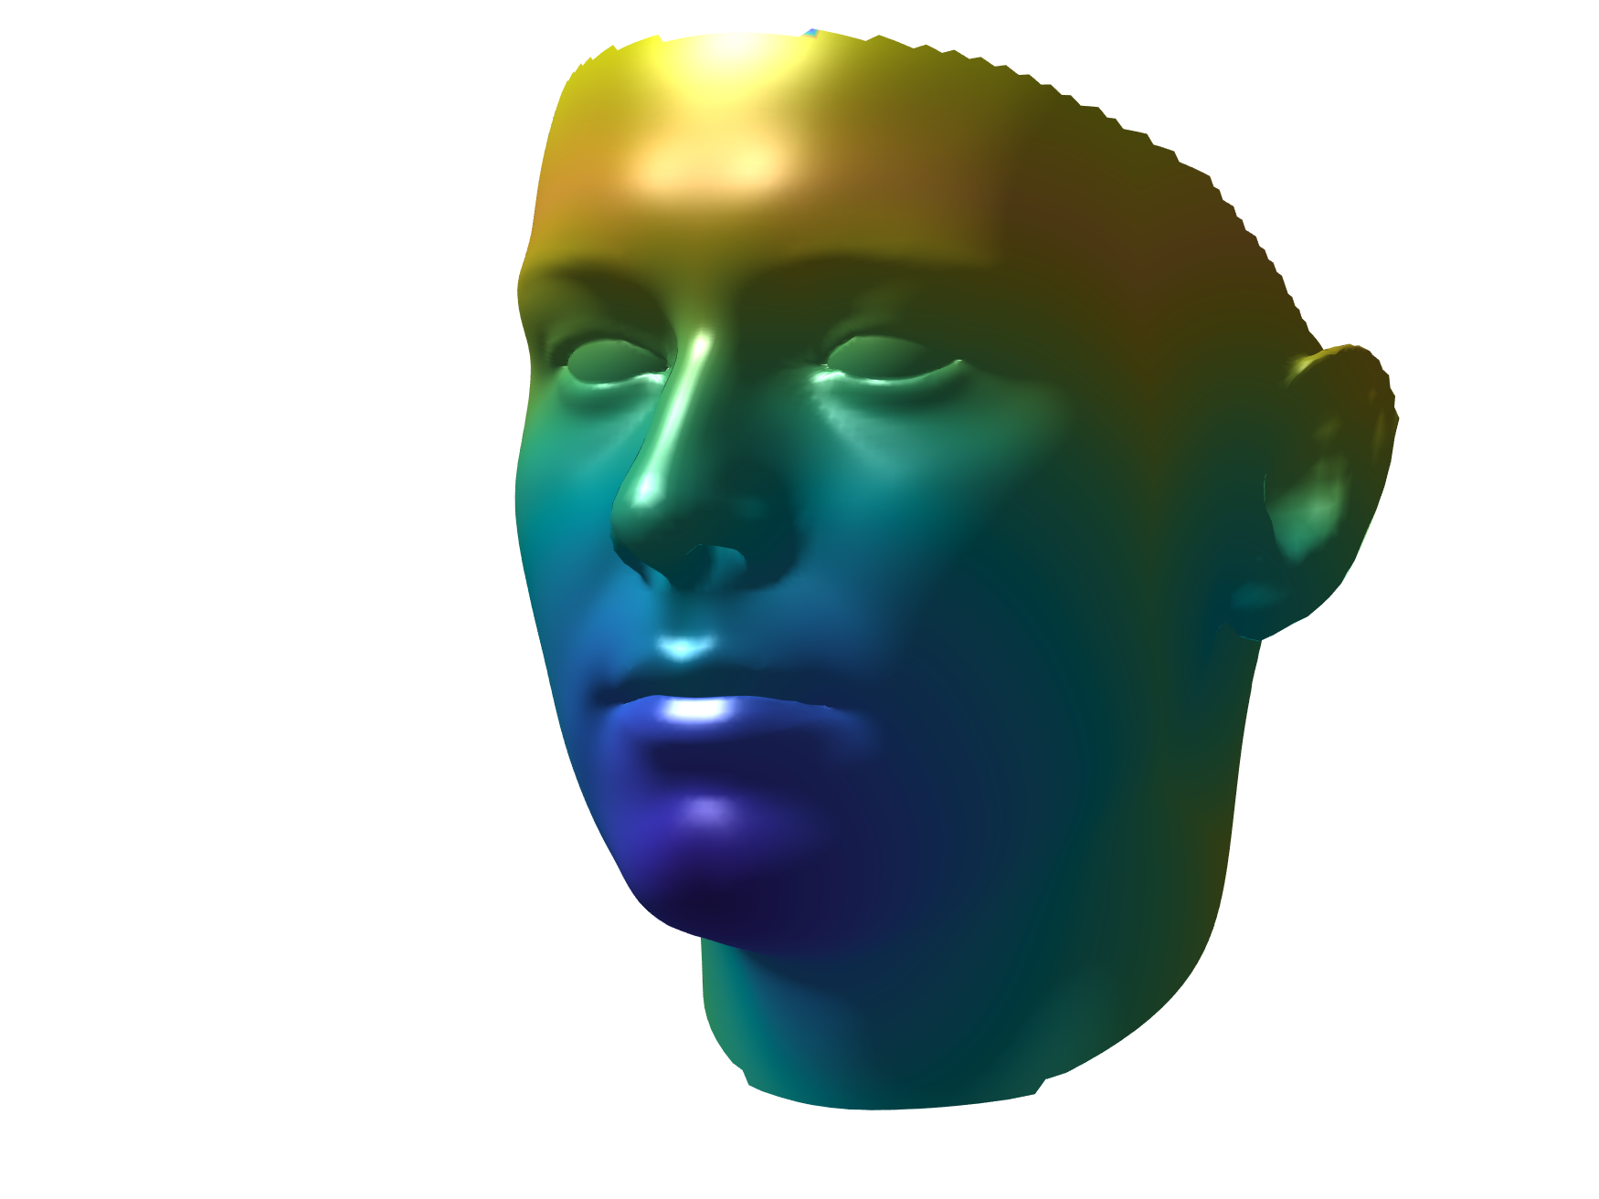
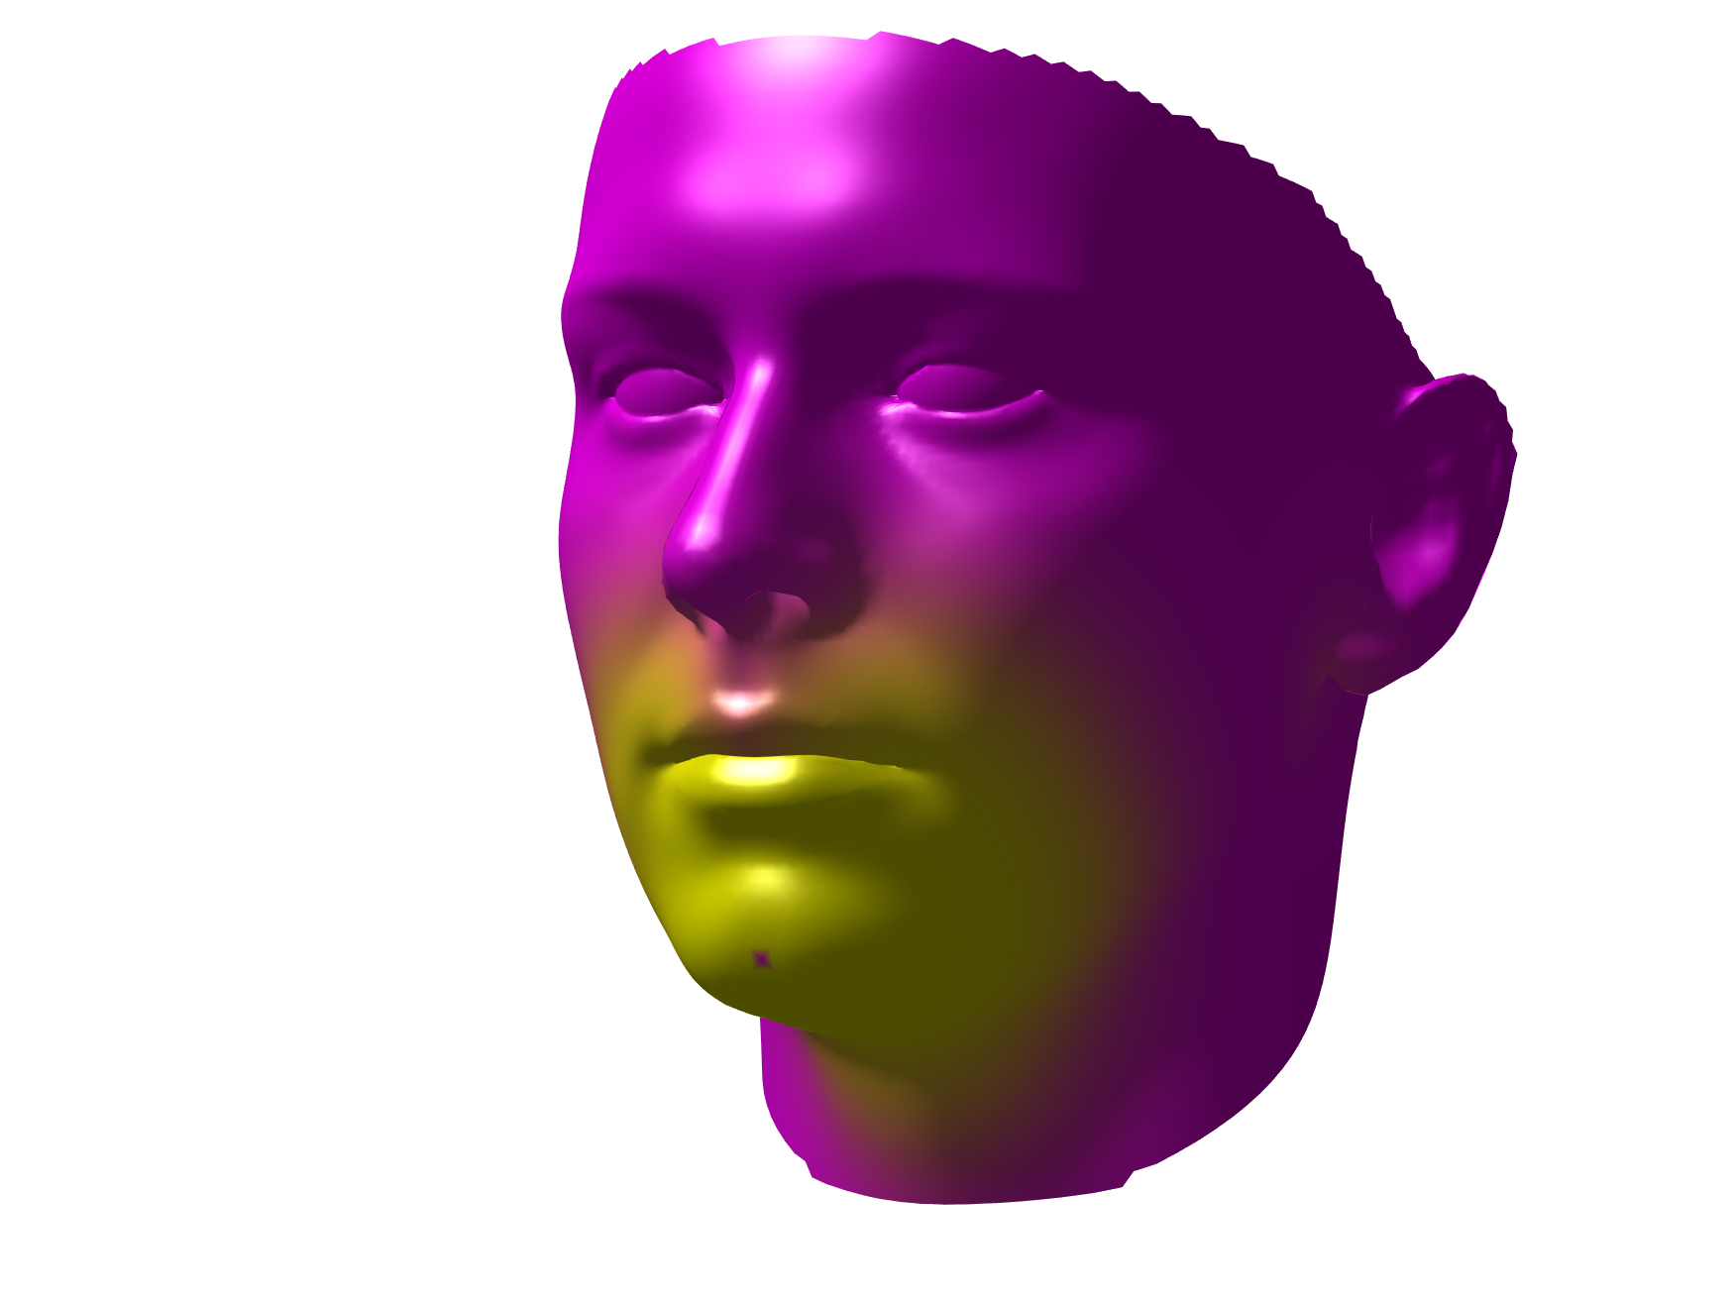
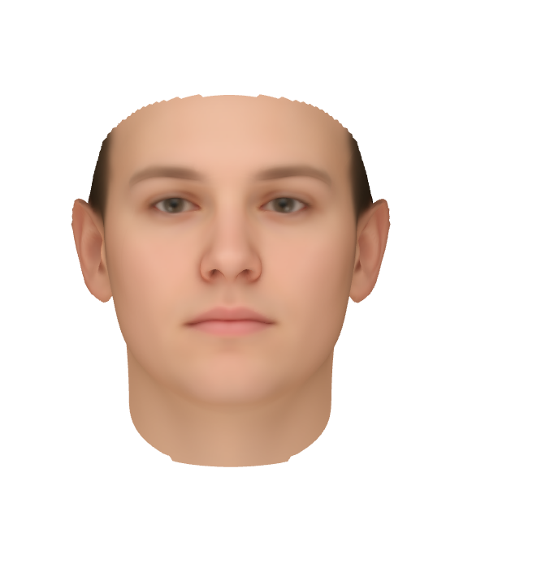
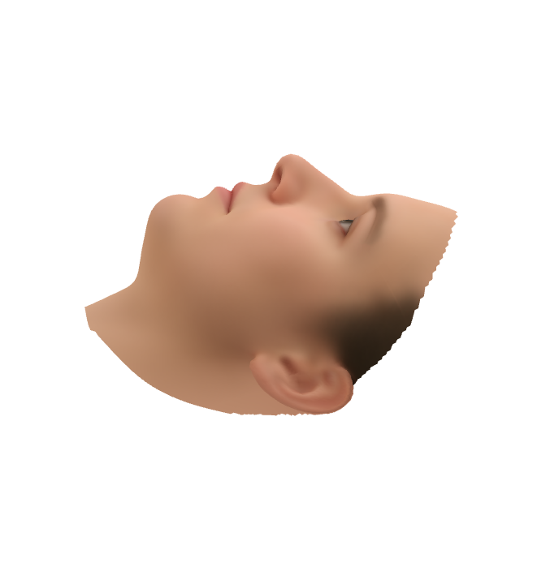
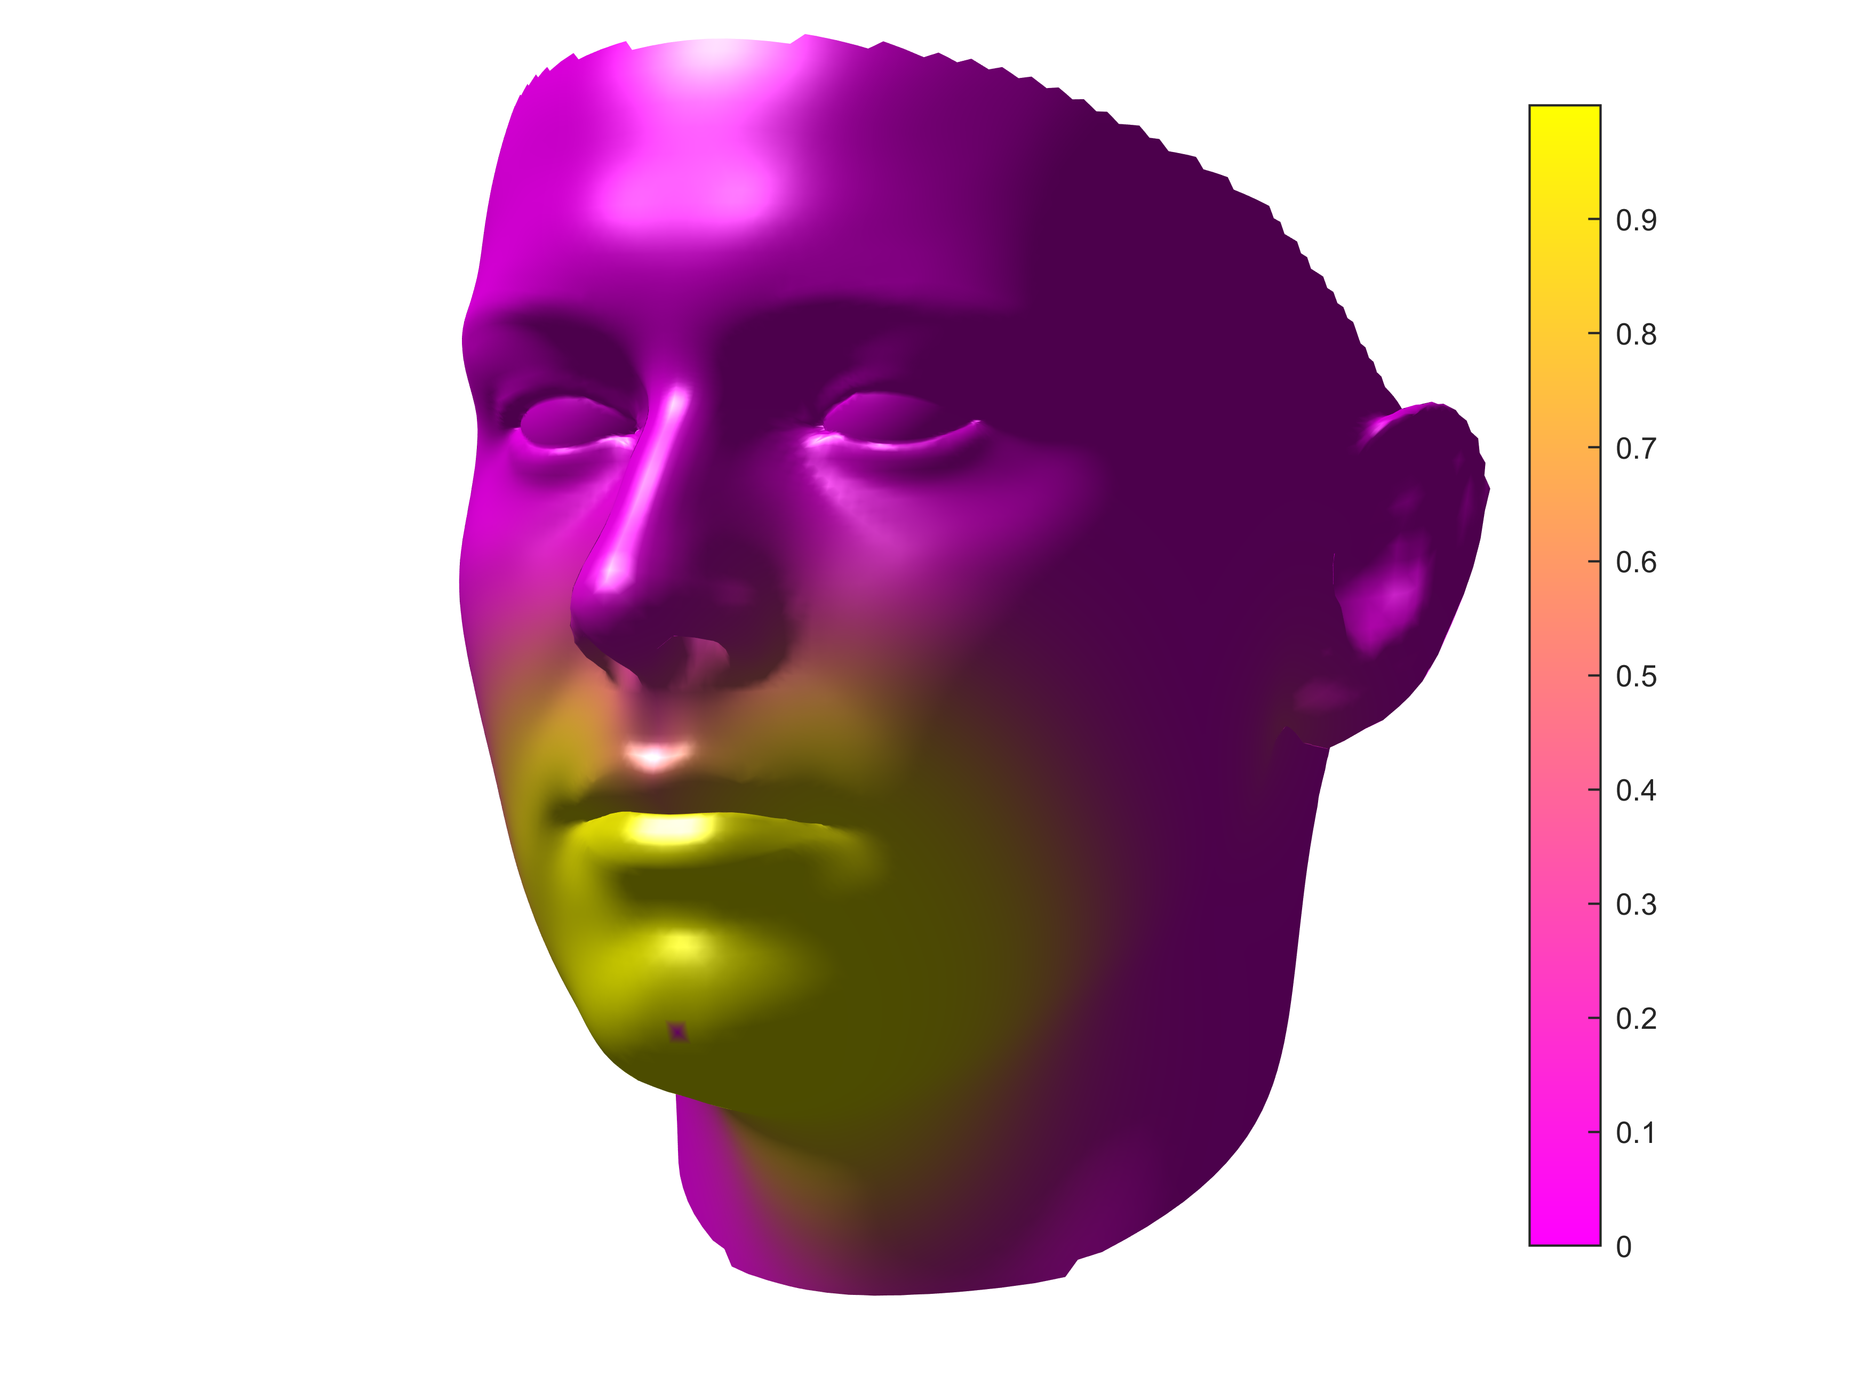
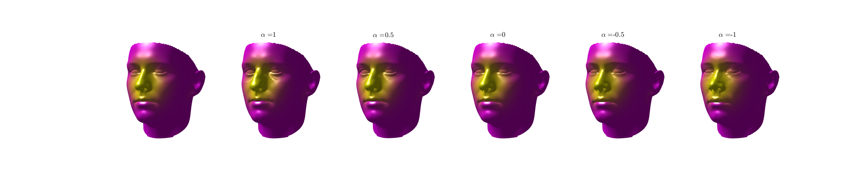
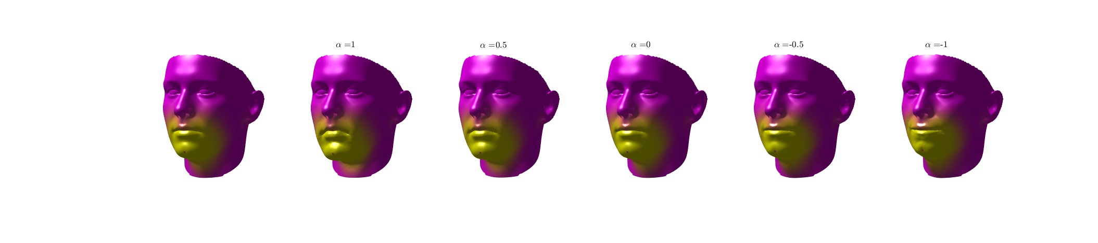
Mask Fitting Test Infrastructure
Geodesic weighting
Weighted PCA w.r.t. features
Attach masks to^{2,3} morphing faces
Correlation² relationship
Face database¹
A
B
C
D
1
E
Examples
0
Nose
Chin
[1.] Gilani et al. "Deep, dense and accurate 3D face correspondence for generating population specific deformable models. (2017)
[2.] Wang et al. "Bridge the Gap: Correlate Face Mask Leakage and Facial Features with 3D Morphable Face Models." (2021)
[3.] Solano et al. "One size fits all?: A simulation framework for face-mask fit on population-based faces." (2021)

Slide 4
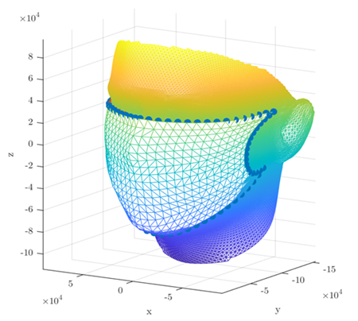
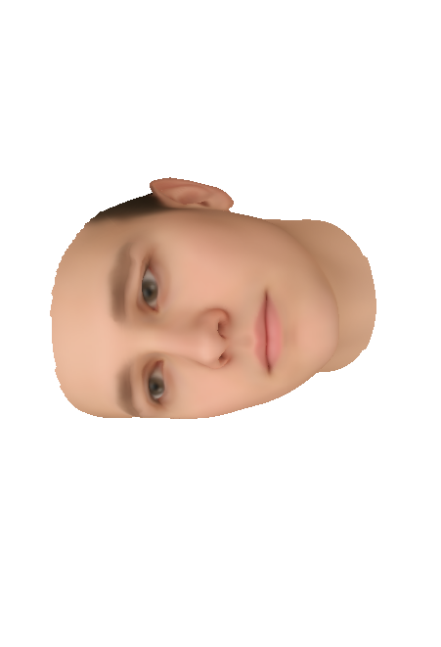
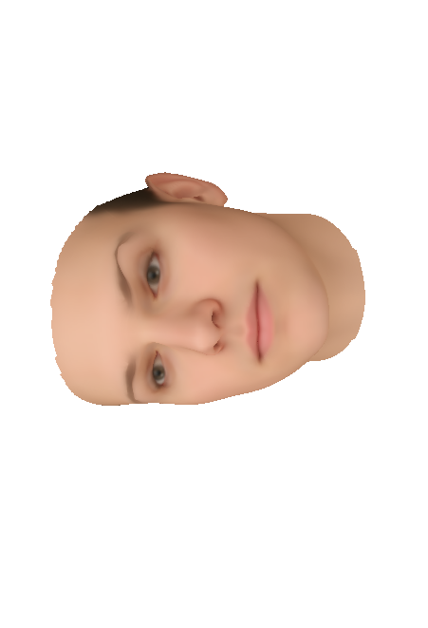
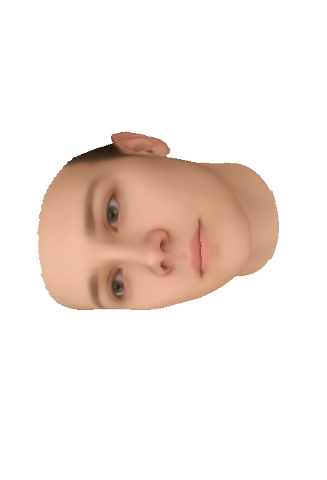

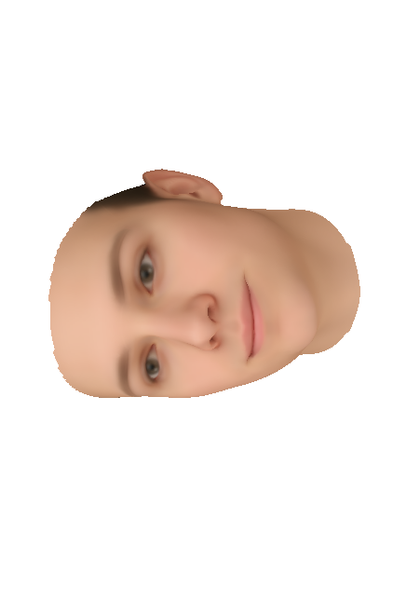
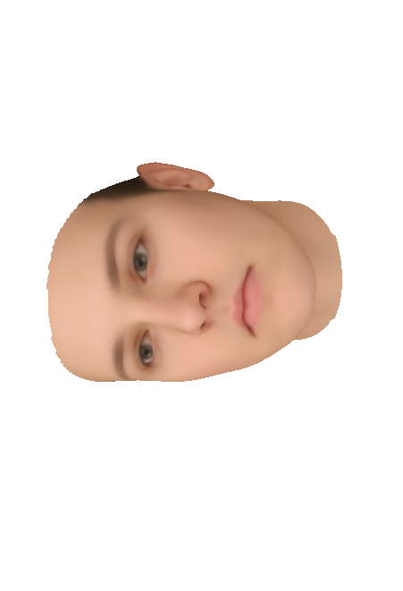
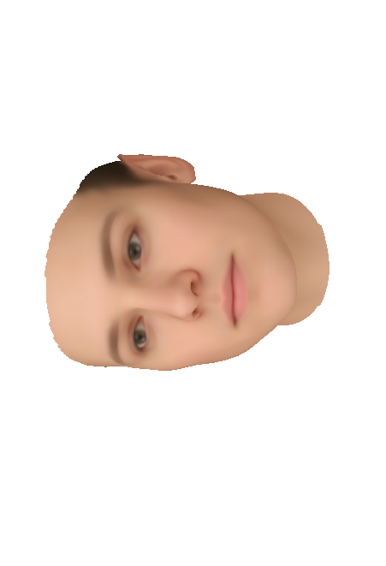
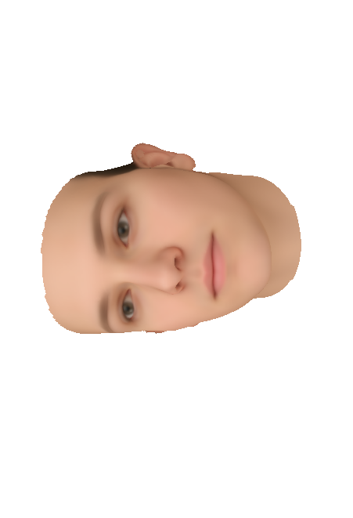

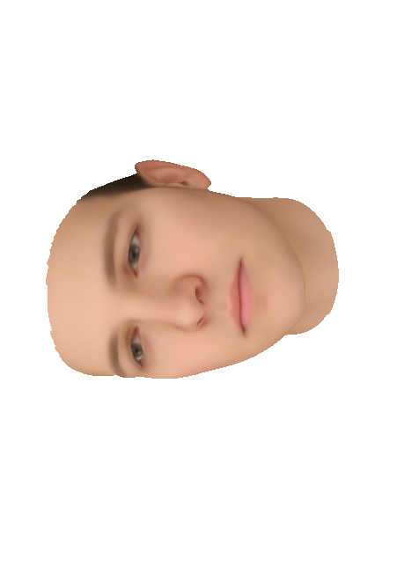

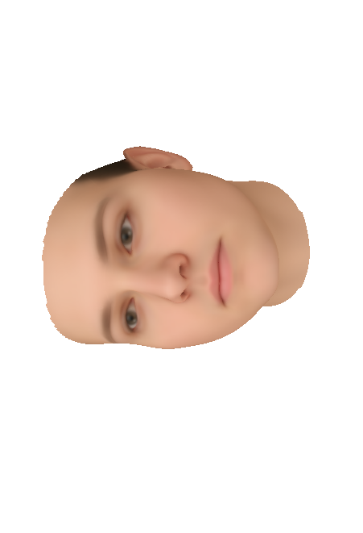
Weighted PCA w.r.t Features
Eyes
Nose
Chin
Ear
Zygomatic arch
Cheeks
Mask is a part of PCA modes, the mean face and the mask are modified together by PCA modes
Wang et al. JESEE, 2021

Slide 5
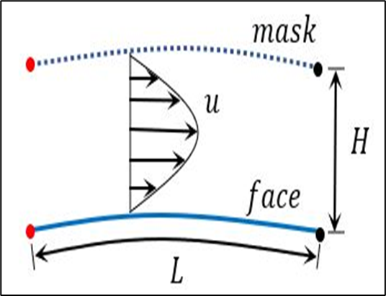
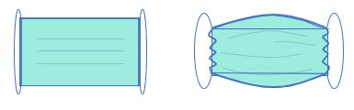

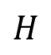
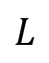
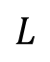
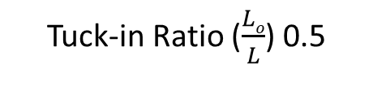
Problem Set-Up
$$L$$
9 X 5 in.
Mask with multiple porous channel having longitudinally varying height
1 . . . . . . . .
50
$$Lo$$
High
Pressure
$$H$$
$$L$$
Without tuck-in
With tuck-in
Geometry Schematics
Velocity Profile
Tuck-in Ratio ($\frac{Lo}{L}$) 0.5
If we know the solution for each mask; the velocity and pressure in channel are related to flux inside each channel
With the iterative process we solve the flow that goes through inner domain and flow that goes to each channel (redistribution happens at entrance of each channel)
This approach is used to compute the distribution of flow in each channel as well as the flow dynamics
[1.] Berman et al. “Laminar Flow In Channels with Porous Walls: J. Applied Physics (1953)

Slide 6
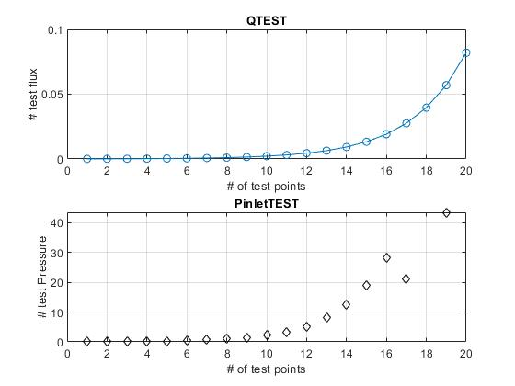
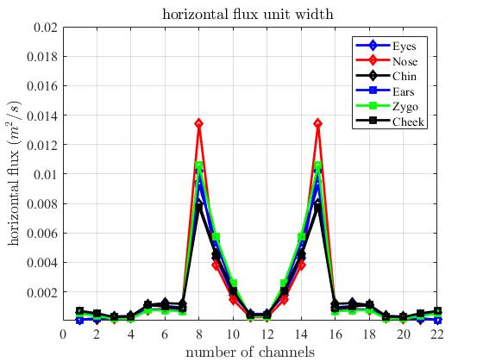
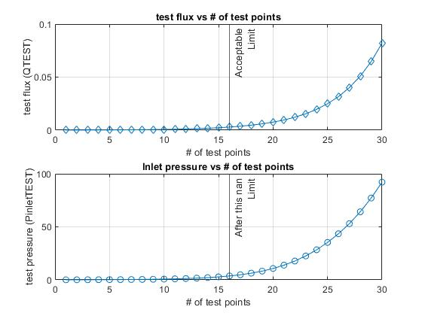
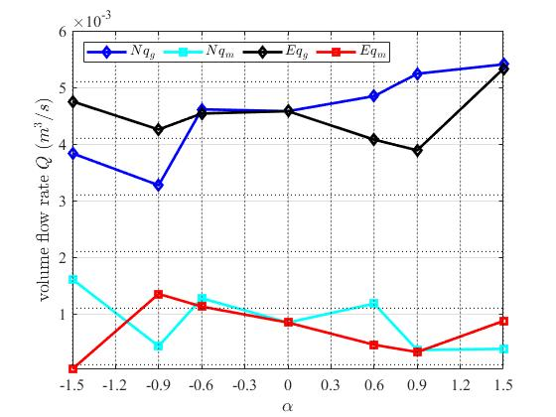
Facial Peripheral leakage
Unique pattern of peripheral leakage for each faces and each facial feature
At alpha = 0 the leakage from each face is similar
As alpha = 0 corresponds to the mean face

Slide 7

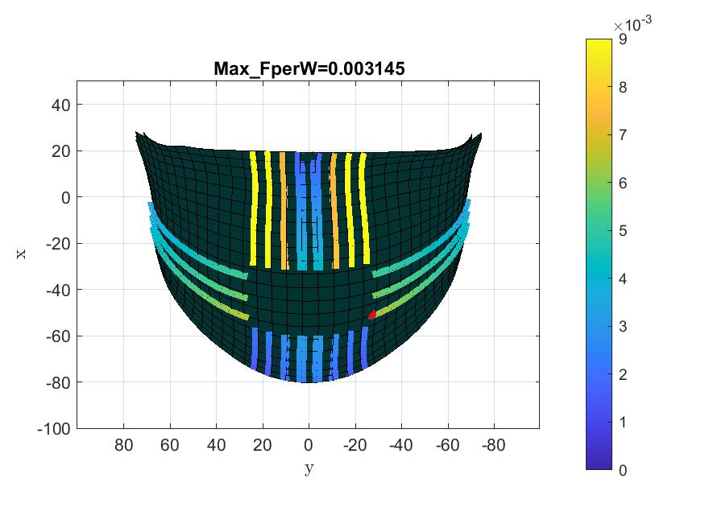
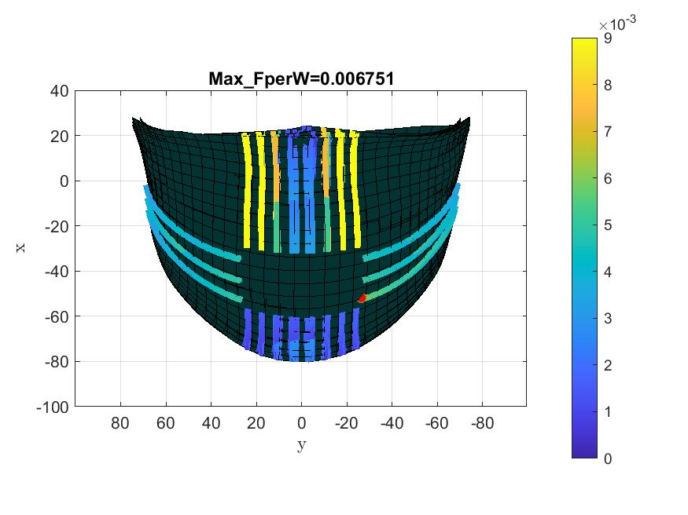
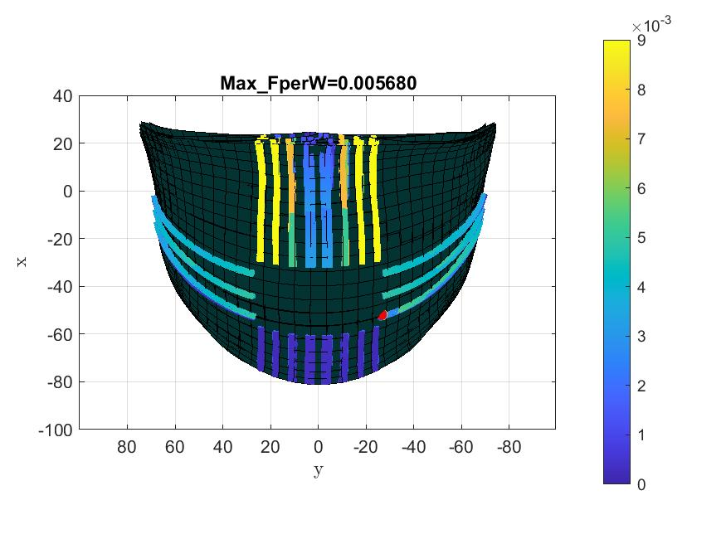
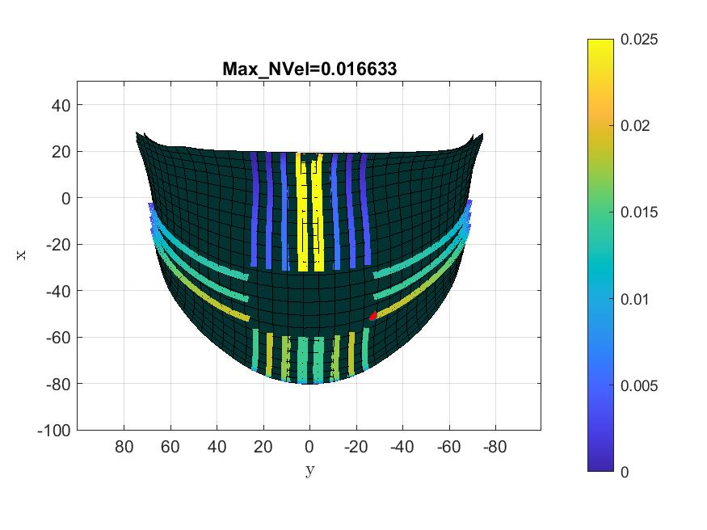
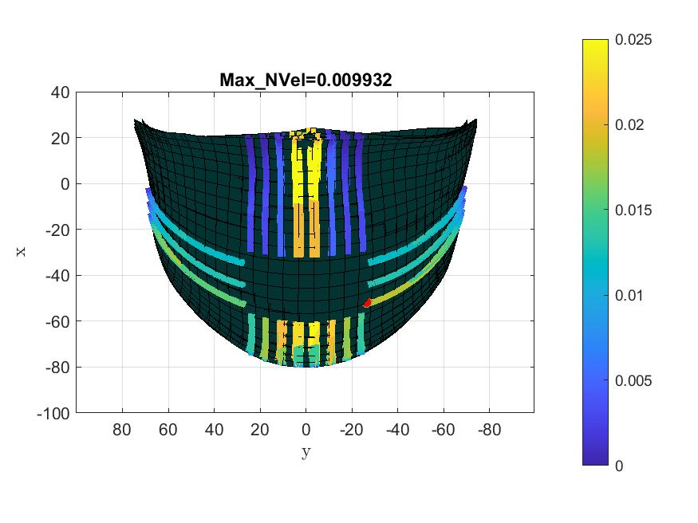
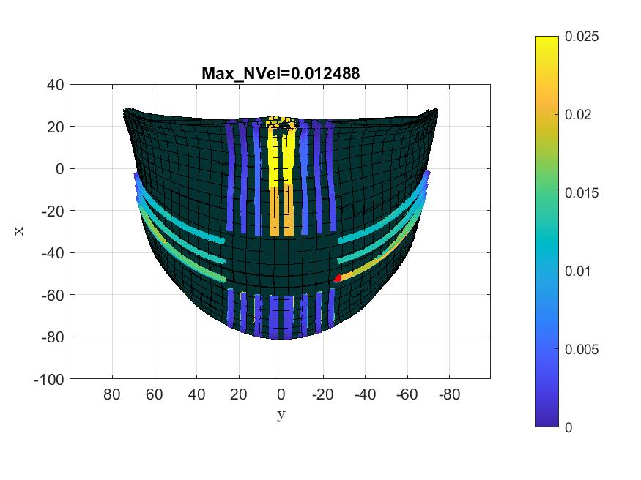


Facial Feature Eyes
$$α=$$
-1.5
$$α=$$
1.5

Slide 8
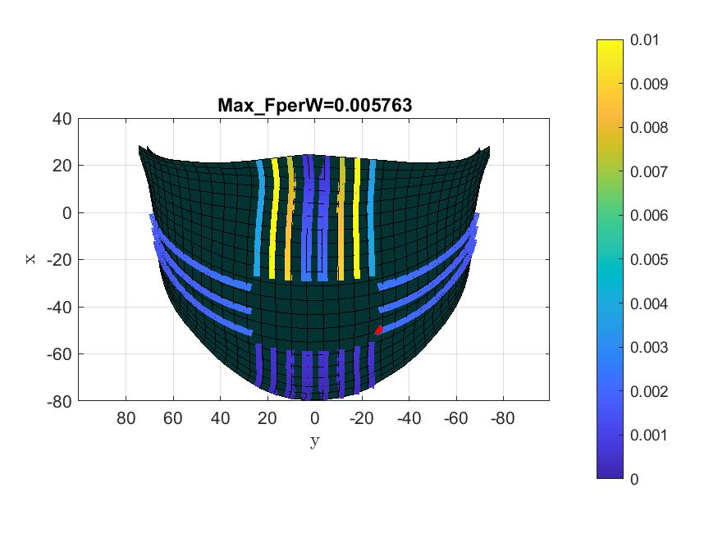
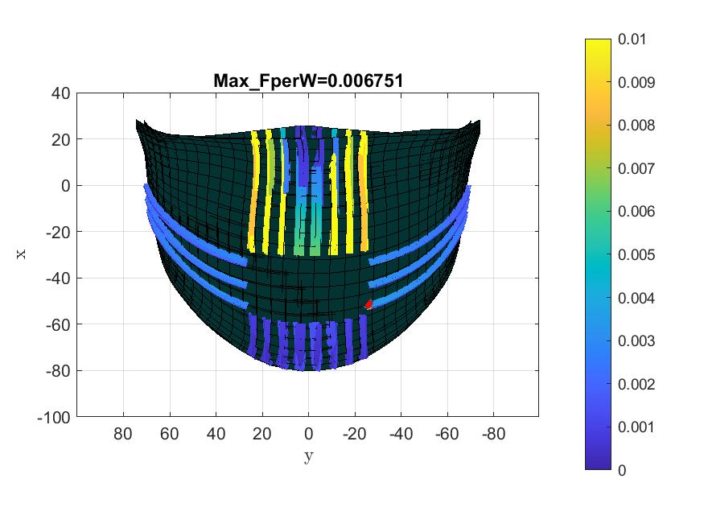
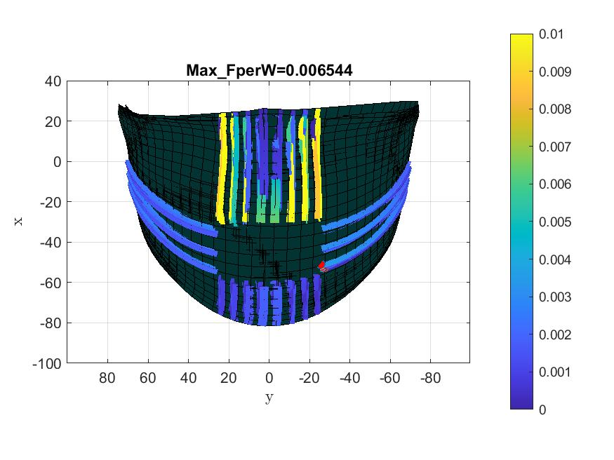
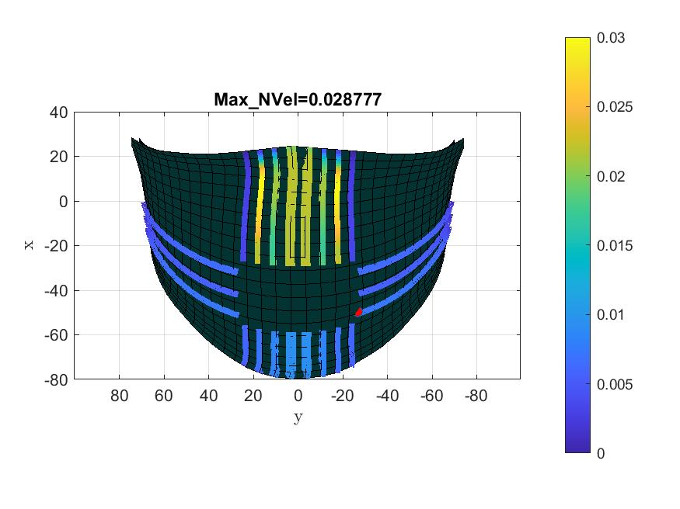
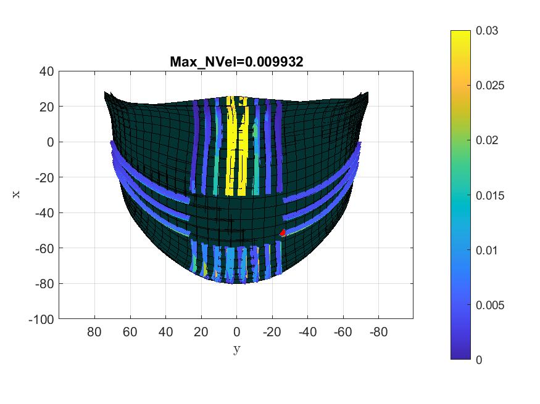
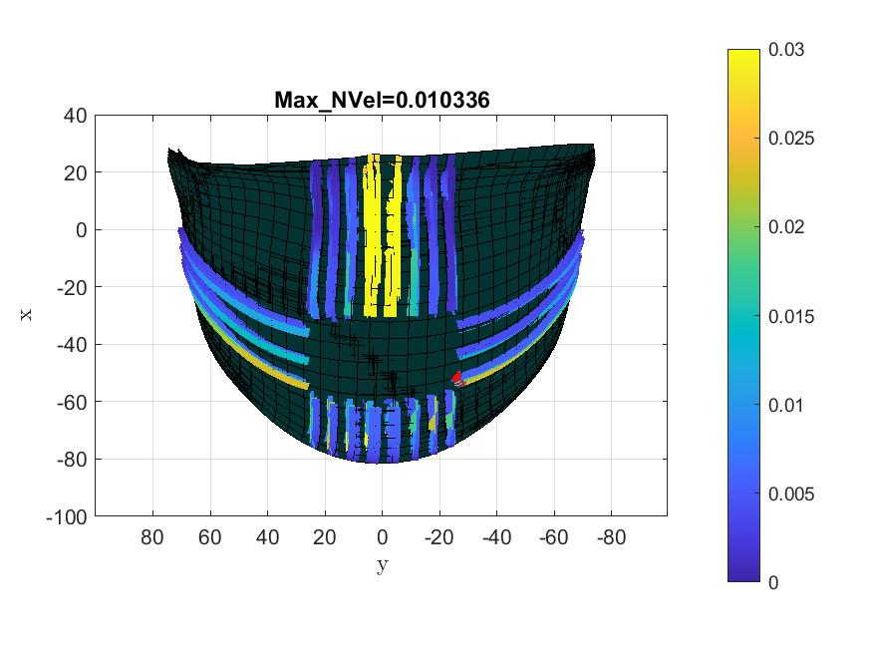
Facial Feature Nose

Slide 9
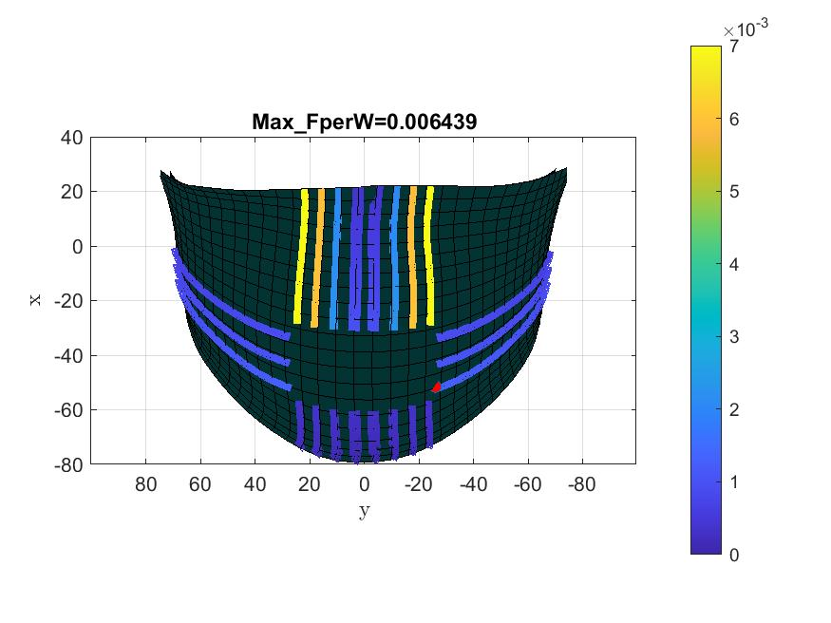


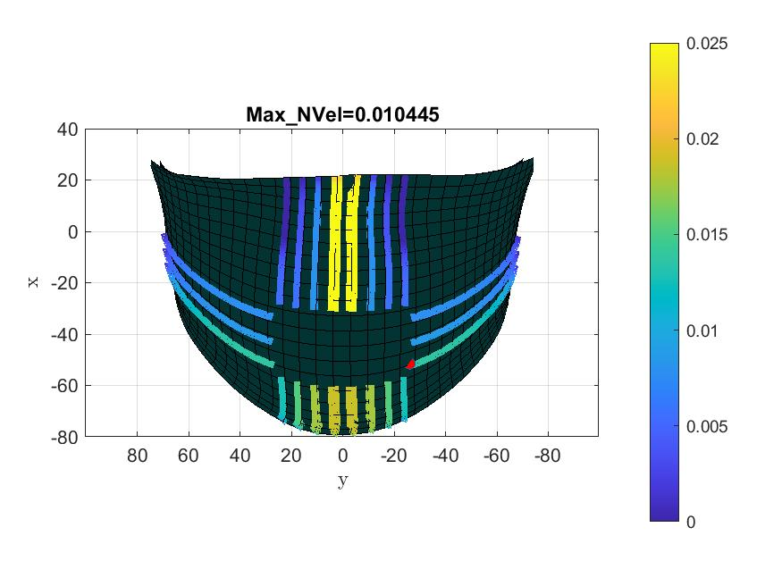
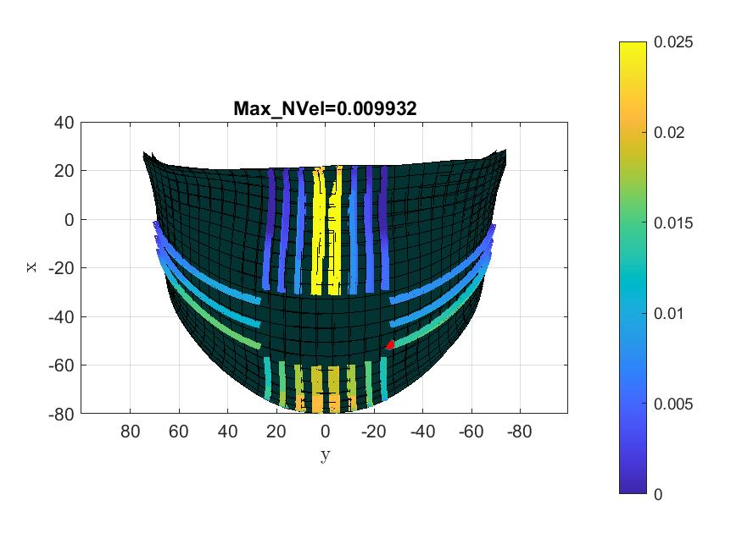
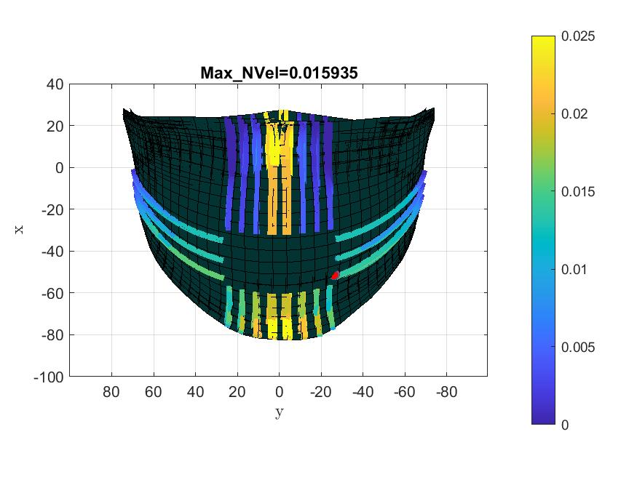
Facial Feature Chin

Slide 10

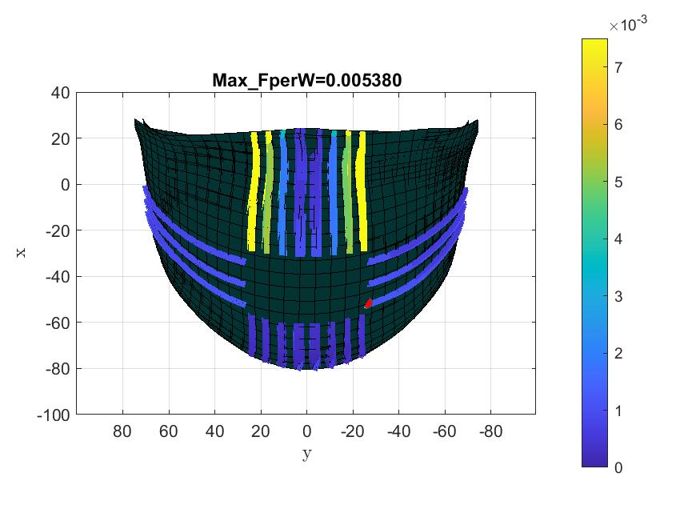


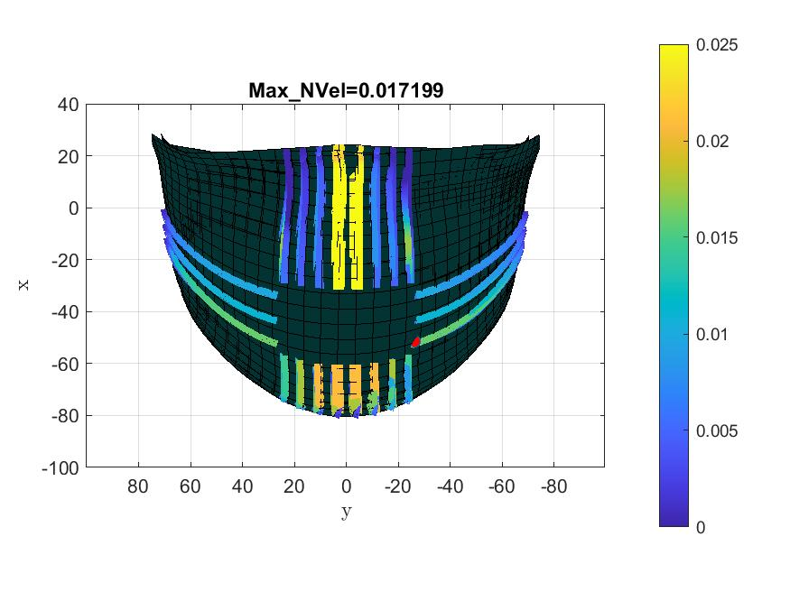
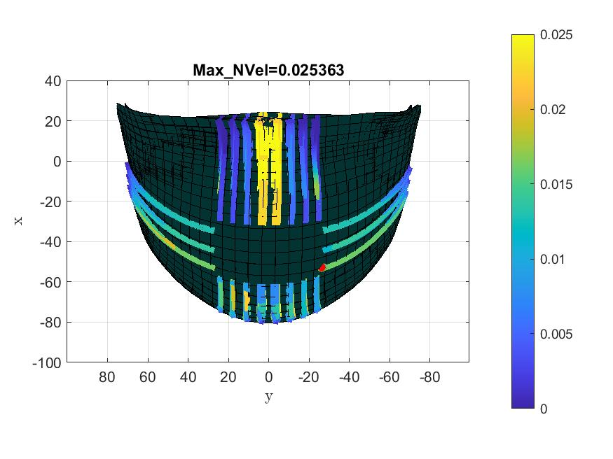
Facial Feature Zygomatic Arch

Slide 11




Facial Feature Comparison
$$Eyes$$
$$Nose$$
$$Chin$$
$$Cheek$$

Slide 12
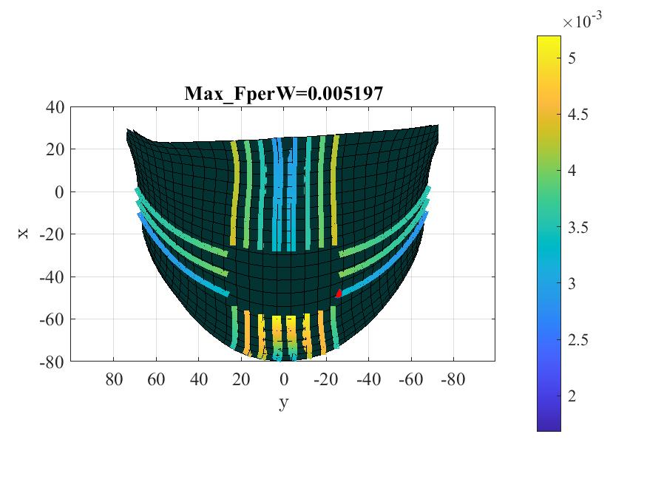
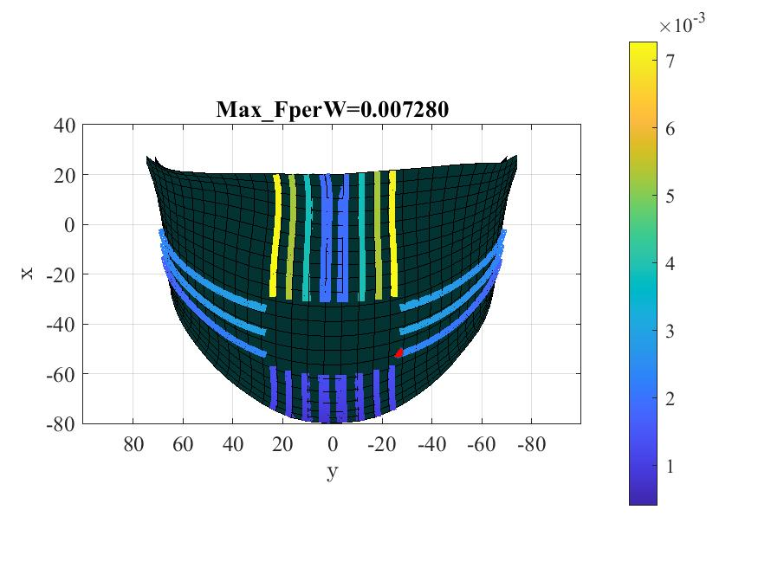
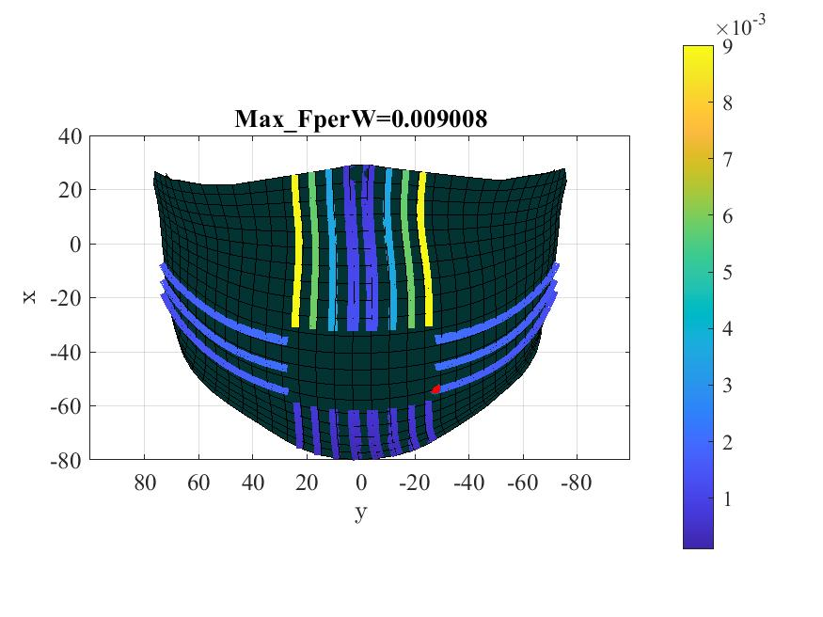






Facial Feature Comparison (Cheek)
Inward Protection
Flux per unit width
The flow leakage is pronounced in cheek regions
The similar behavior is seen for chin cases too
The overall leakage is dominant on all channels placed on nose and chin
$∝ =−1.$5
$$∝ =0$$
$$∝ =1.5$$
Outward Protection

Slide 13





Facial Feature Comparison (Cheek)
Inward Protection
Normal velocity
Mostly flow leaks from the cheek regions for IP with alpha = 0
The distribution of normal velocity is uniform in in the cheeks
$∝ =−1.$5
$$∝ =0$$
$$∝ =1.5$$
Outward Protection

Slide 14


Slide 16
Development Timeline
Past week
This week
Next week
Activities/Issues
Ongoing Effort
Plan/Thoughts
Mask outward protection
Mask inward protection
Wrap up outward protection part of paper
Wrap up outward & Inward protection paper
FEM model / FSI
Outcomes
Success/Failure
Major Results
Anticipated Results
Literature on Jet Velocity
4 cases fails (P=nan) for facial feature ears
Flux per unit width for each facial feature
Normal velocity
Jet velocity
Reynolds number based on channel opening

Slide 17
Facial Peripheral leakage
Unique pattern of peripheral leakage for each faces and each facial feature
At alpha = 0 the leakage from each face is similar
As alpha = 0 corresponds to the mean face

Slide 18






Facial Peripheral leakage

Slide 19






Facial Peripheral leakage

Slide 20





Facial Feature Comparison (Eyes)
Inward Protection
Flux per unit width
The flow leakage is pronounced in nose tips
The overall trend is similar from both IP and OP cases
$∝ =−1.$5
$$∝ =0$$
$$∝ =1.5$$
Outward Protection

Slide 21





Facial Feature Comparison (Eyes)
Inward Protection
Normal velocity
Mostly flow leaks from the cheek regions for IP
The flow leakage is pronounced in nose center and chin tips joining nose
$∝ =−1.$5
$$∝ =0$$
$$∝ =1.5$$
Outward Protection

Slide 22

Facial Feature Comparison (Nose)
Inward Protection
Flux per unit width
The flow leakage is pronounced in nose tips and chin and nose intersection for IP case
The overall leakage is dominant on all channels placed on nose
$∝ =−1.$5
$$∝ =0$$
$$∝ =1.5$$
Outward Protection

Slide 23




Facial Feature Comparison (Nose)
Inward Protection
Normal velocity
Mostly flow leaks from the cheek regions for IP
The flow leakage is pronounced in nose center
The distribution of normal velocity is uniform in for outward protection for $α=−1.5$
$∝ =−1.$5
$$∝ =0$$
$$∝ =1.5$$
Outward Protection

Slide 24
Facial Feature Comparison (Cheek)
Inward Protection
Flux per unit width
The flow leakage is pronounced in cheek regions
The similar behavior is seen for chin cases too
The overall leakage is dominant on all channels placed on nose and chin
$∝ =−1.$5
$$∝ =0$$
$$∝ =1.5$$
Outward Protection

Slide 25
Facial Feature Comparison (Cheek)
Inward Protection
Normal velocity
Mostly flow leaks from the cheek regions for IP with alpha = 0
The distribution of normal velocity is uniform in in the cheeks
$∝ =−1.$5
$$∝ =0$$
$$∝ =1.5$$
Outward Protection

